Slide 1
Exercise Log for 8/16/21
10
Low Impact/Walk

Slide 2
Session 17: Other Ways to Do Exercises

Slide 3
Discussion question:
Why do we need to know how to get up from the floor?

Slide 4
Floor Exercises
Before beginning floor exercises, consider trying out the buddy system. If you are afraid you won’t be able to get back up, adopt a buddy who will be able to provide assistance if you need it. Knowing the right way to get into a lying position on the floor and the right way to get back up also may be helpful to you.
If you have had a hip replacement, check with your surgeon before using the following method. If you have osteoporosis, check with your doctor first.
We will not practice these today in class.

Slide 5
The following instructions are outlined with pictures in the Complete Exercise Routine found in the back of the manual.
To get into a lying position:
Stand next to a very sturdy chair that won't tip over (put chair against wall for support if you need to).
Put your hands on the seat of the chair.
Lower yourself down to on one knee.

Slide 6
Bring the other knee down.

Slide 7
Put your left hand on the floor and lean on it as you bring your left hip to the floor.

Slide 8
Your weight is now on your left hip.

Slide 9
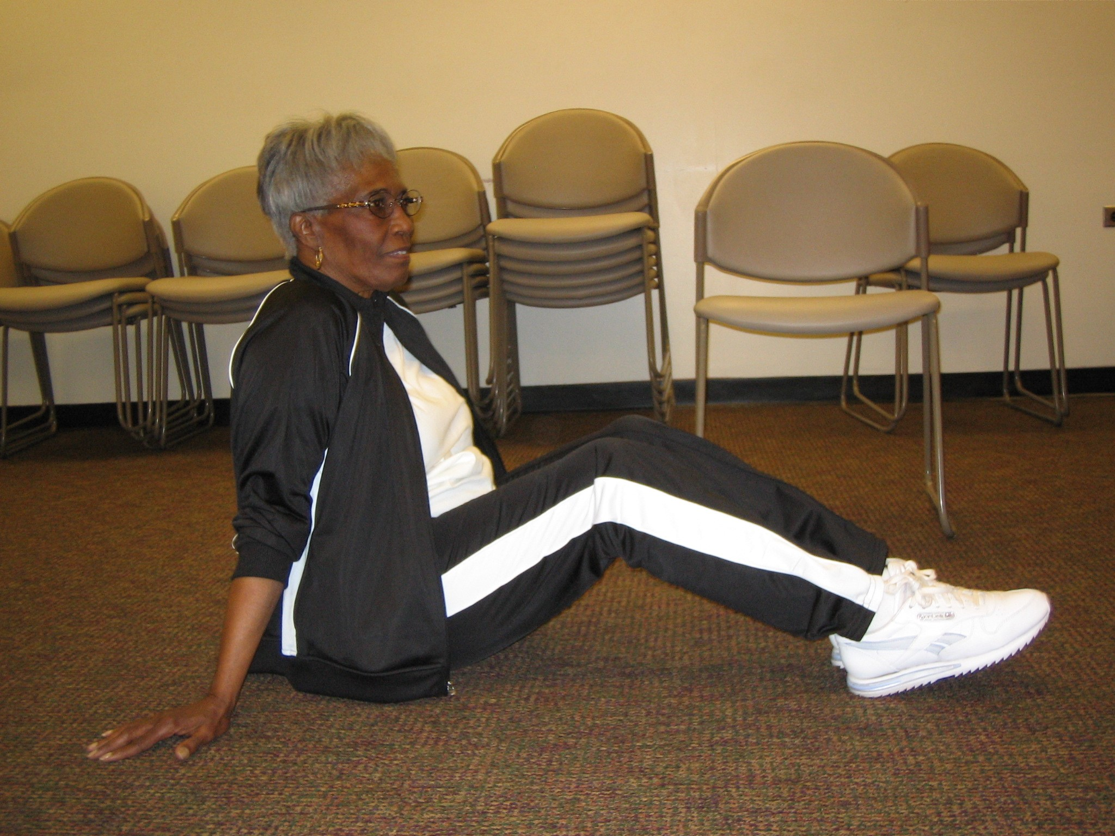
Straighten your legs out.

Slide 10
Lie on your left side.
Then roll onto your back.

Slide 11
To get up from a lying position:

Slide 12
SOME EXERCISES YOU CAN DO IN BED
BEFORE GETTING OUT OF BED
Reminder-Benefits of stretching:
Greater freedom of movement.
Improvement in posture.
Increase in physical and mental relaxation.
Release of muscle tension and soreness.
Reduced risk of injury.
It is beneficial to stretch before getting out of bed. While you sleep your body shifts blood and warmth from your muscles to the organs that need them at night, so in the morning, your muscles are cold and vulnerable to sprains and strains. Doing these simple exercises in bed can help reduce stiffness, get your blood circulating and help you start the day.

Slide 13
Bed Exercises at Home Doing these simple exercises in bed before you get out of bed can help reduce stiffness, get your blood circulating and help you start the day.
Hip Stretch
Lie on your back. Keep your right leg straight and on the bed. Then bend your left leg up onto your chest. Hold for 5 seconds. Then lower your right leg. Repeat with the other leg. Repeat 5 times.

Slide 14
Hamstring Stretch
Lie on your back. Bend your left knee. Then, keeping your right leg straight, raise your right leg as high as possible. Hold for 3-5 seconds. Then repeat with the left leg 5 times.

Slide 15
Abdominal and Shoulder Stretch
Lie on your back. Bend both knees. Flatten the hollow of your back against the bed. Hold this position and then pull your shoulder blades together. Hold for 5 seconds. Repeat 5 times.

Slide 16
Abdominal Crunches
Lie on your back. Bend both knees. Stretch your arms out in front of you. Try to raise your head and shoulders off the bed. Repeat 5 times.

Slide 17
Exercises that can be performed in bed or on floor
Quadriceps Exercises:
Lie on your side.
Rest your head on a pillow or your hand.
Bend the knee of the leg that is on top.
Grab the heel of that leg.
Gently pull that leg until front of thigh stretches.
Hold this position.
Roll over to your other side and repeat with your other leg.

Slide 18
Double Hip Rotation: Don't do this exercise if you have had a hip replacement, unless your surgeon approves.
Lie with your back on the floor with your knees bent.
Keep your shoulders on the floor at all times.
Keeping your knees together, lower your legs to one side.
Hold this position.
Return your legs to an upright position.
Repeat toward the other side.

Slide 19
Using Weight Machines
There are many different types of weight machines. They differ in the way in which they provide resistance. Each machine needs to be set up a little differently. If you are unsure of what to do, check with the fitness floor supervisor. When used properly weight machines provide a safe and stable method of increasing strength.

Slide 20
PROS:
Pros using machines
Machines provide stability to joints around the exercising muscle.
Machines help guide the movement.
Machines are good for beginners, as the weights are under control of the machine.

Slide 21
How do you set up weight machines?
Each machine needs to be set up a little differently, so if unsure of what to do, check with the fitness floor supervisor. You can apply these general principles:
Familiarize yourself with each machine by trying it first with no weight (pull the weight pin out so that there are no weights in the weight stack). Check that the movement does not cause strain to your joints. The axis of movement for the target joint and muscles should align with the axis of motion of the machine. Discuss with your fitness instructor how to position your body properly on the machine.
You may be able to adjust seat height, stabilizing pads, or limit the amount of motion. Adjust seat height, etc. to make sure the machine fits your body size.
Write down what settings you use.
Selecting the amount of weight to use:

Slide 22
How do you set up weight machines? (con’t)
Estimate an amount of weight that you can easily lift with good form.
If you can lift that amount easily 10-12 times, add a weight.
If you feel like the last repetitions are difficult or if you cannot maintain good form then reduce the weight.
Once you identify a weight that you can lift 10-12 repetitions with only moderate difficulty, you next select the number of sets. A set is a group of successive repetitions performed without resting. Start with one set, progress to 2-3 sets.
You should rest about 1 minute between sets
Training Tips:
When using weight machines, be certain that the weight pins are secured before you begin repetitions.
DO NOT bang weights; lower the weight stack slowly down to its original position upon completion of repetition.
DO NOT hold your breath-this is called a Valsalva maneuver. It increases the pressure in your chest and is a strain on your heart.

Slide 23
Leg Extension Machine

Slide 24
Why is appropriate form important?
As mentioned above, appropriate form is one way to tell if the weights are too heavy for you. But form is also important to make sure that you are not putting strain on other joints in the body. When using proper form:
a. Use good postural alignment. Chin level, shoulders back, tummy pulled in.
b. Use a full range of motion but only as long as you can control the weight.
c. Do not hyperextend at the elbow or knee.
d. Only use the muscles targeted by the machine. Do not strain with your back or neck.
e. You should be able to control the lift of the weight with a smooth movement. Do not use a jerky motion.

Slide 25
How do you progress the weights?
By the end of the second week of strength training, you should start to notice that it is easier to do 2-3 sets of 10-12 repetitions. It is now time to reassess the difficulty of each exercise with your current level of weights! Try adding a weight from the stack. Can you lift it 10-12 times with only moderate difficulty? Since you have increased the weight you can drop down the sets, and once again build up to 2-3 sets. Because the weight stack is in fixed increments (10-15 lbs.), it can be difficult to increase to next weight level.

Slide 26
Why Is Progression Important?
To take full advantage of the many benefits of strength training, it's important to progress, or consistently advance the intensity of your workout by challenging your muscles with heavier weights. This continuous challenge allows your muscles to grow strong and stay strong. Progressing will boost your feelings of independence and will help ensure that you live well into old age without the fear of falling. It will also give you a tremendous sense of pride and accomplishment.
(CDC website on Strength Training for Older adults-Free weights
http://www.cdc.gov/nccdphp/dnpa/physical/growing_stronger)

Slide 27
Let's Try Some New and Exciting Activities!
Maybe you feel that some exercises just aren't exciting enough. You want to work out but feel bored by the more traditional exercises like walking, or swimming, or bicycling. Here are some examples of activities that may help to liven up your exercise routine.

Slide 28
Golf
Thanks to the popularity of golf greats like Tiger Woods, golf has become the sport of choice for many Americans. While some may believe golf is not a demanding sport, it actually requires a great deal of strength and stamina. The key components involved in golf are strength and power, flexibility, and cardiovascular conditioning. Golf is a great way to experience a moderate activity while learning a fun sport.

Slide 29
Tennis
Perhaps you are thinking that tennis is too much of a workout. But how about doubles? Not only is it less strenuous but doubles tennis also provides a great social environment. Tennis provides one of the best aerobic and anaerobic workouts. If playing an entire game becomes too difficult, you can also use a tennis ball machine to hit balls.

Slide 30
Hiking
There's nothing like getting away from our daily hectic lives and getting some fresh air while taking in beautiful views. Hiking allows you to escape the pressures of life while providing a great mind/body exercise and relaxation.

Slide 31
Cross Training
Maybe you have started feeling bored after a few months of your swim class or dance class. Well then, it is time to start cross training. Cross training combines two or more types of exercise into your routine physical activity. Cross training helps to alleviate boredom and prevent injuries from overworking certain muscles.

Slide 32
Great Job Everyone!! See you again on Thursday!

