Slide 1
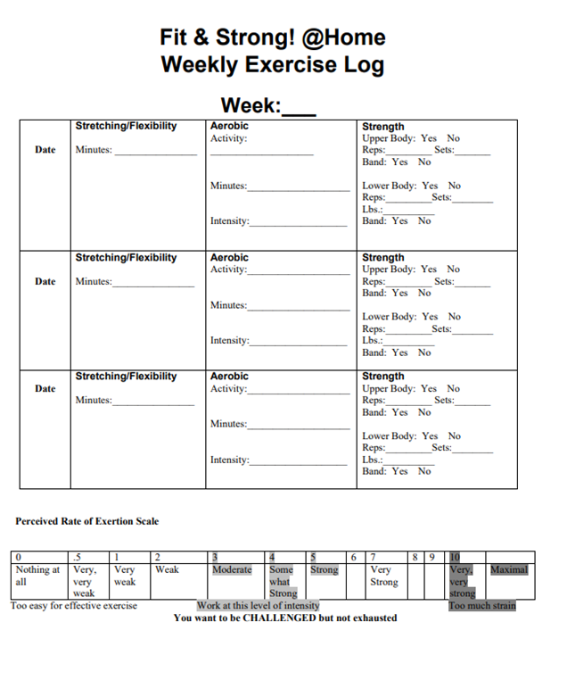
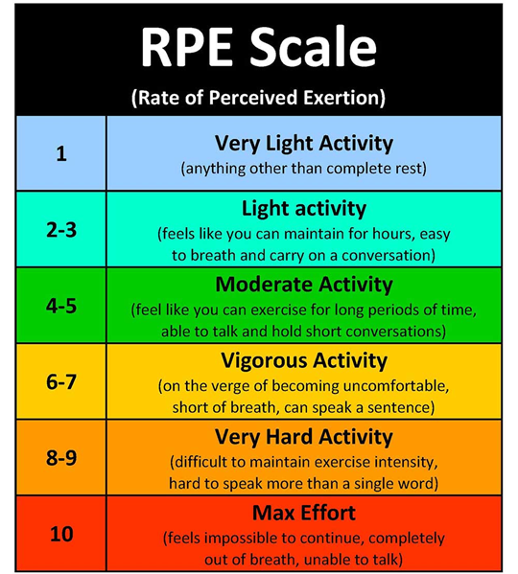
Exercise Log for 8/2/21
10
Low Impact
10
2
8/2/21
25
10
2

Slide 2
Session 13:
Cool-Down Exercises
Group Discussion:
Why is it important to cool-down?

Slide 3
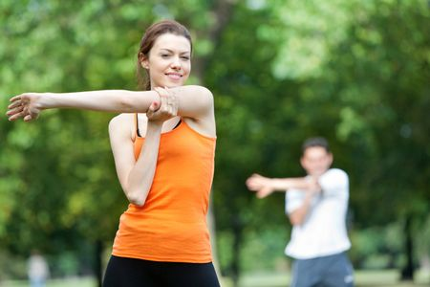
Benefits of Cool-Down Exercises
Cool-Down Exercises at the end of an exercise session:
Enable you to relax.
Prevent blood from pooling in the legs after exercise.
Will prevent you from feeling light headed.
Will help to prevent muscle soreness after exercise.

Slide 4
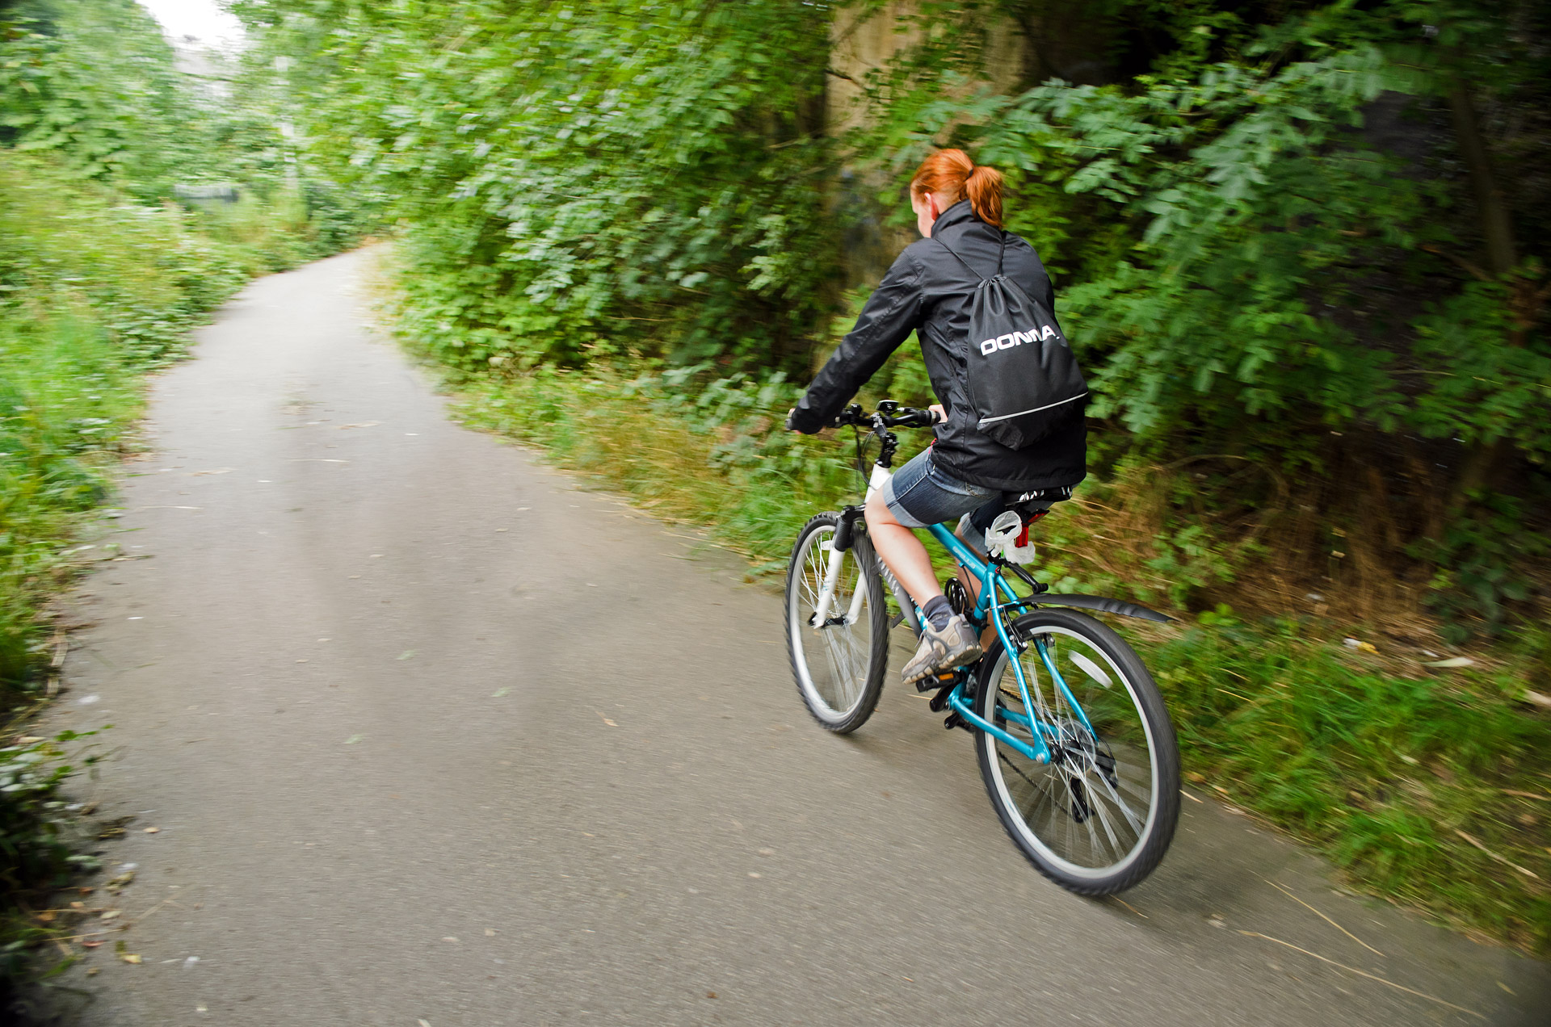
How to cool down and relax:
After doing most of your strenuous exercises, take five extra minutes to cool down and relax.
If you were walking, walk at a slower pace for five more minutes.
If you were bicycling, cycle at a progressively slower pace for the last five minutes.

Slide 5
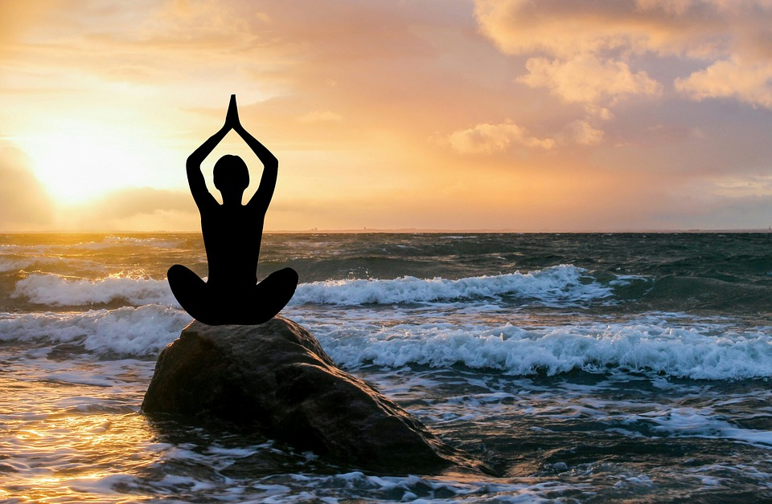
In our exercise class we have cooled down by using a combination of stretching, isometric muscle contractions followed by relaxation, and relaxed breathing techniques. You may practice this at home.

Slide 6
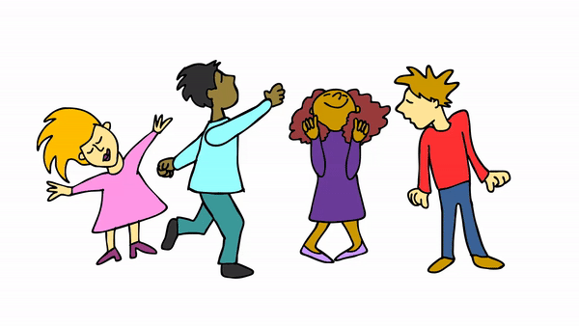
Great Job Everyone and have a great night! See you Thursday!

