Slide 1
The Physical Activity Guidelines Midcourse Report: Implementation Strategies for Older Adults
Notes:
Note: This PowerPoint was developed to support discussion and presentations related to the Physical Activity Guidelines Midcourse Report. The slides review the development process, high-level findings, and how various professionals and organizations can play role in implementation. Slides can be edited or removed as needed to best serve the needs of your audience.

Slide 2
Background

Slide 3
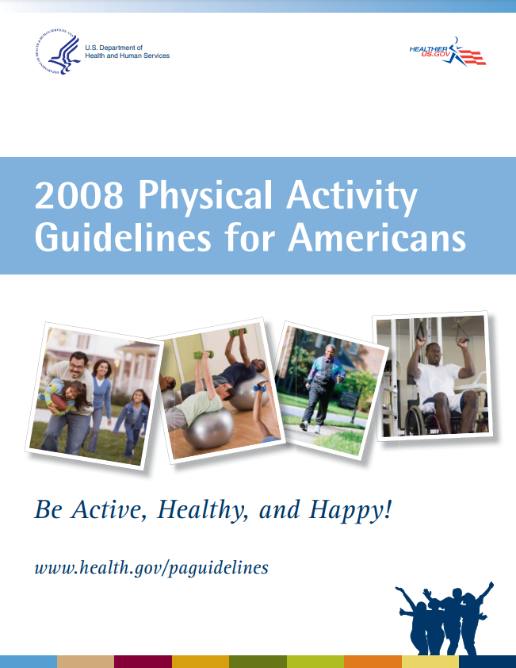
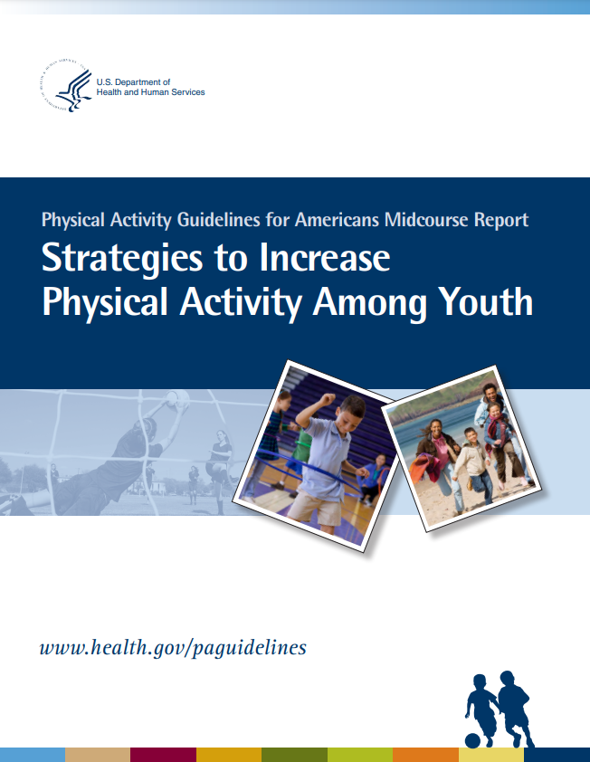
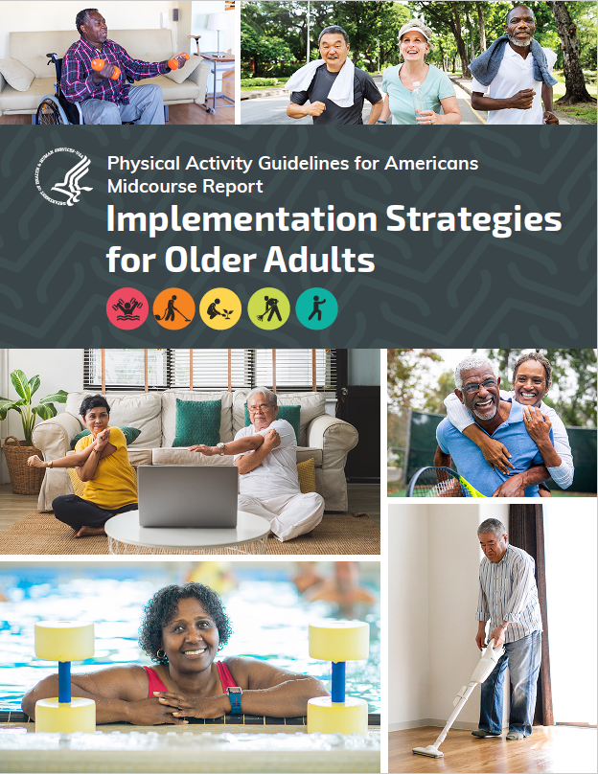
History of The Physical Activity Guidelines
2008
2013
2018
2023
Notes:
The first edition of the Physical Activity Guidelines for Americans was released in 2008. It was the first comprehensive guidance on physical activity from the federal government.
Five years after the release of the first edition of the Physical Activity Guidelines for Americans, the U.S. Department of Health and Human Services (HHS) released the first Physical Activity Guidelines Midcourse Report, focusing on how to get youth more active to meet the Guidelines of at least 60 minutes a day.
In 2018, 5 years after the Midcourse Report and 10 years after the first edition, HHS released the second edition of the Physical Activity Guidelines for Americans, which reflects the expanded evidence base.
5 years later, in June 2023, HHS released another midcourse report, focused on how to get older adults more active to meet the guidelines.
The main difference between the full editions of the guidelines and the midcourse reports is that the full editions are examining health outcomes and provide the amounts and types of physical activity Americans need to get and stay healthy, while the midcourse reports are implementation focused, examining physical activity outcomes and strategies to get more Americans to meet the guidelines.
All reports are based on extensive systematic literature reviews, which are available on health.gov.

Slide 4
Why Focus on Older Adults?

Slide 5
How much activity do older adults need?
Notes:
This graphic here depicts the key guidelines for older adults. First, older adults have the same guidelines as all adults to get at least 150 minutes of moderate-intensity aerobic physical activity each week and at least 2 days a week of muscle-strengthening physical activity.
In addition to that, older adults should get multicomponent physical activity that includes aerobic, muscle strengthening, and balance activity.
When older adults cannot meet these recommendation because of chronic conditions, they should be as physically active as their abilities and conditions allow.

Slide 6
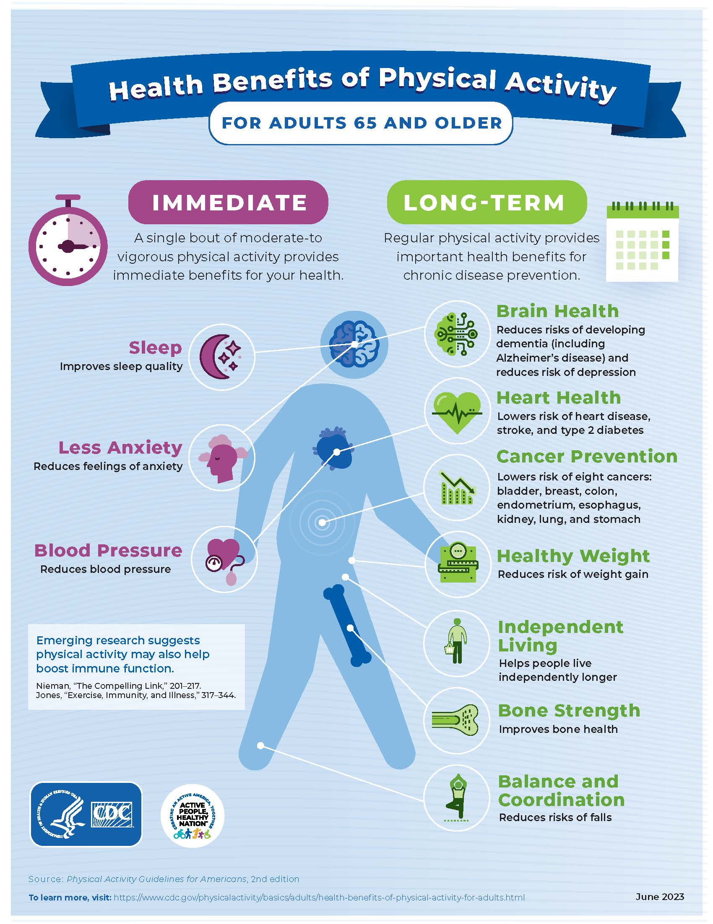
The Cost of Inactivity
Health Benefits of Physical Activity for Adults 65 and Older
Notes:
These are several health benefits available to older adults. Older adults can obtain immediate benefits from doing a session of physical activity, or benefits associated with regular physical activity done across time or as a lifestyle behavior.
The benefits of physical activity occur throughout life and are key for healthy aging. Benefits that are especially relevant to older adults include:
falls prevention and reduced risk of fall-related injury
reduced risk of dementia (including Alzheimer's disease)
and improved physical function, helping older adults perform activities of daily living more easily and maintain their independence.
In addition to reducing the risk of chronic diseases, physical activity has benefits for people with chronic health conditions and disabilities, such as:
decreased pain for people with osteoarthritis,
reduced cardiovascular disease progression for people with hypertension,
And improved cognition for people with dementia
A more detailed list of the benefits of physical activity for older adults can be found in tables 1 and 2 in the midcourse report.
[Link to graphic: Health Benefits of Physical Activity for Children, Adults, and Adults 65 and Older | Physical Activity | CDC]
[Learn more about physical activity and older adults: https://www.cdc.gov/physicalactivity/basics/older_adults/index.htm]

Slide 7
The Cost of Inactivity
Physical inactivity could be responsible for $27 billion in direct health care costs annually between 2020 and 2030
Older adults’ personal health care spending is 5 times higher than that of children and 3 times higher than adults
Approximately 7.8 percent of deaths among adults aged 70 years and older are attributed to not meeting the aerobic physical activity Guidelines
Notes:
Among all age groups, older adults have the lowest rates of meeting the recommendations in the Guidelines, and they also have the highest health care costs.
The World Health Organization (WHO) predicts that physical inactivity will be responsible for $27 billion in direct health care costs annually worldwide (not factoring in productivity losses) between 2020 and 2030
In the United States, personal health care spending for adults age 65 years and older was $19,098 per person in 2014 — over 5 times higher than spending for children ages 0 to 18 years ($3,749 per person) and almost 3 times the spending for adults ages 19 to 64 years ($7,153 per person).
Physical activity can help people prevent or manage many costly chronic conditions that are common in older adults, including heart disease and stroke, cancer, diabetes, obesity, and arthritis.
Approximately 7.8 percent of deaths among adults age 70 years and older (and 10 percent of deaths among adults ages 40 to 69 years and) are attributed to individuals not meeting the aerobic physical activity Guidelines

Slide 8
Physical Activity and Chronic Diseases
Notes:
About 1 in 2 adults live with a chronic disease. Only half of adults get the physical activity they need to help reduce and prevent chronic diseases.
1 in 10 premature deaths could be prevented by getting enough physical activity. It could also prevent:
1 in 8 cases of breast cancer
1 in 8 cases of colorectal cancer
1 in 12 cases of diabetes, and
1 in 15 cases of heart disease
[Link: https://www.cdc.gov/physicalactivity/downloads/healthy-strong-america.pdf]

Slide 9
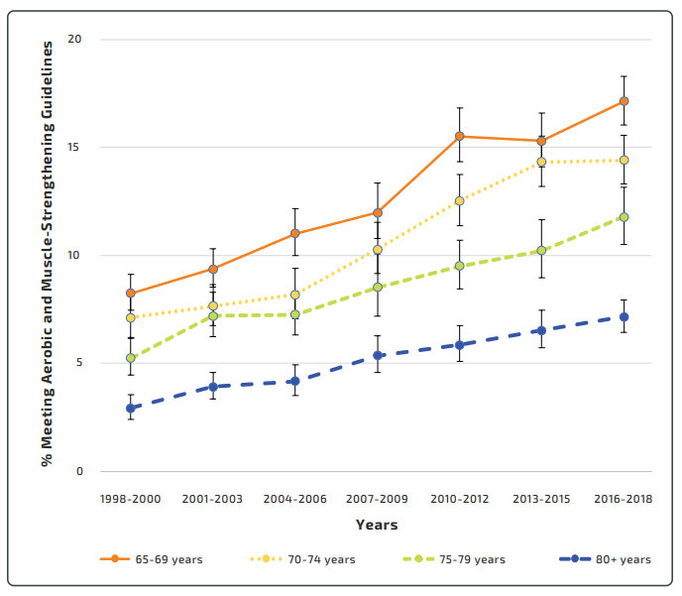
Prevalence of Meeting the Aerobic and Muscle-Strengthening Guidelines Among Older Adults by Age Group—National Health Interview Survey, 1998-2018
Source: Source: Centers for Disease Control and Prevention. National Health Interview Survey—1998-2018. https://www.cdc.gov/nchs/nhis/1997-2018.htm.
Notes:
Older adults have low rates of meeting the Guidelines – only about 15% of older adults in the United States meet the aerobic and muscle-strengthening guidelines.
This graph depicts data from 1998 to 2018, and although older adults have become more active in recent years, older adults still continue to become less active as they age.

Slide 10
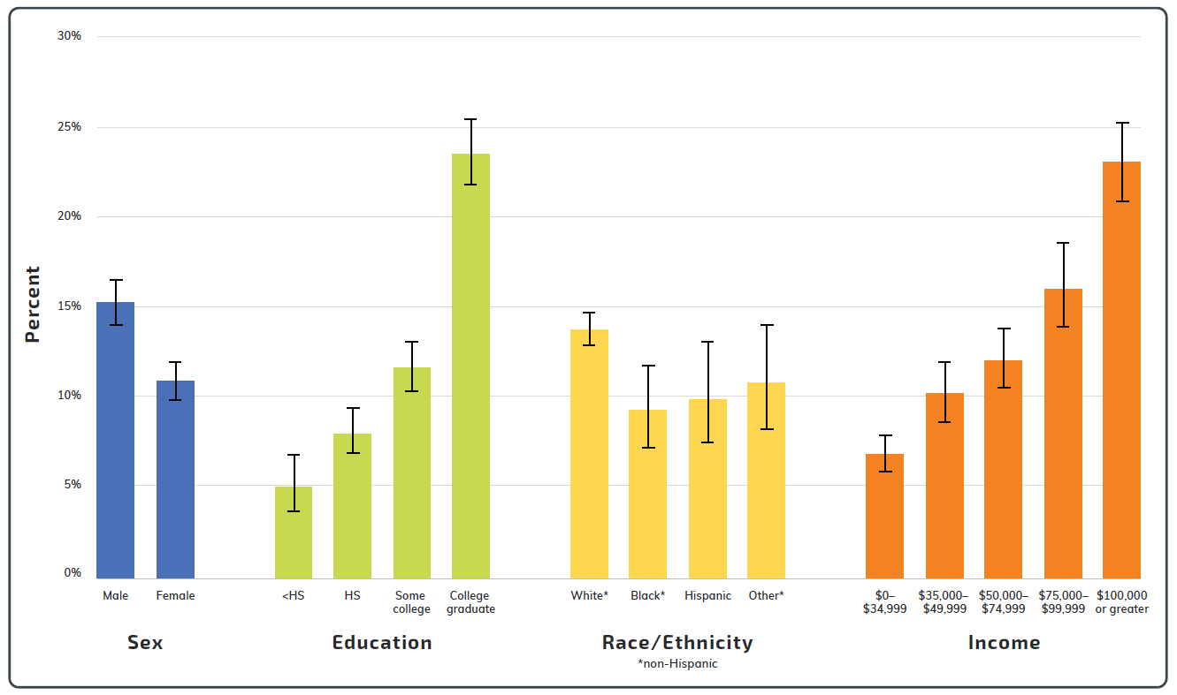
Prevalence of Meeting the Aerobic and Muscle-Strengthening Guidelines Among Older Adults by Demographic Subgroup — National Health Interview Survey, 2020
Source: Centers for Disease Control and Prevention. National Health Interview Survey (NHIS), 2020.
Notes:
Despite the physical, mental, social, and economic benefits of being physically active, older adults do not have equitable access to these benefits. For example, women, people with less education, and those with lower incomes have lower levels of physical activity than their peers.
There are many barriers to getting or staying physically active that can contribute to these disparities.
This includes individual-level barriers such as chronic health conditions, fear of falling, physical or cognitive limitations, and pain.
And community-level barriers such as inequitable access to spaces, equipment, or guidance, and neighborhood environment characteristics (like low-quality sidewalks or poor lighting). When developing the midcourse report, HHS sought to identify strategies that can help reduce these barriers and make it easier for all older adults to get active.

Slide 11
Barriers to Physical Activity
Capability-related barriers — individual attributes such as chronic health conditions, physical or cognitive limitations, and pain.
Opportunity-related barriers — external factors such as social isolation; inequitable access to spaces, equipment, or guidance; neighborhood environment characteristics; and environmental limitations.
Motivation-related barriers — personal attitudes and beliefs; fear of falling, pain, or injury; low self-efficacy, knowledge, and awareness; or lack of enjoyment.
Notes:
Many older adults face barriers to getting or staying physically active. These barriers often relate to older adults’ capabilities, opportunities, or motivation. Understanding the different barriers older adults face is key to delivering effective and equitable interventions.
Capability-related barriers include individual attributes such as:
chronic health conditions
physical or cognitive limitations, and
pain.
Opportunity-related barriers include external factors such as:
social isolation;
inequitable access to spaces, equipment, or guidance;
neighborhood environment characteristics like low-quality sidewalks or poor lighting; and
environmental limitations like climate-related issues.
Motivation-related barriers include personal attitudes and beliefs, such as:
the perception that it is too late to start being active;
fear of falling, pain, or injury;
low self-efficacy, knowledge, and awareness; and
lack of enjoyment.
Insufficient social support and societal biases related to age can exacerbate motivation-related barriers.

Slide 12
Development of the Midcourse Report

Slide 13
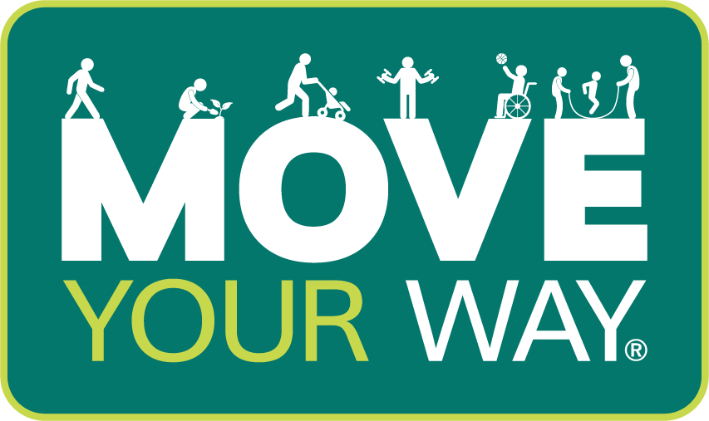
Developing the Midcourse Report
PAG Midcourse Report on Older Adults
Systematic Literature Review
Comments on Draft Report
Peer Review
HHS Clearance
Scientific Experts
Notes:
The process for developing the Midcourse Report began with the reinstatement of the President’s Council on Sports, Fitness & Nutrition Science Board to conduct a systematic literature review. The literature review examined evidence from the current scientific literature regarding the effectiveness of behavioral strategies, intervention delivery modes and settings, and policy-driven approaches for promoting physical activity in older people.
Once the literature review was completed, a writing team of physical activity subject matter experts at HHS used the literature review—as well as successful interventions from Step It Up! The Surgeon General’s Call to Action to Promote Walking and Walkable Communities and The Guide to Community Preventive Services—to develop a draft of the Midcourse Report. The draft was then put it out for public comment, peer review, and federal agency comment.
The writing team received input from members of the public, other federal agencies, non-federal organizations, and 6 academic experts in physical activity and older adults, and incorporated feedback into a final draft of the report, which then went through formal departmental clearance, which ensures that there is agreement and consistency across HHS.
Since releasing the report, HHS has been working to disseminate findings to professionals across the United States, as well as continue to promote the Guidelines and the importance of physical activity to older adults through the Move Your Way campaign (the promotional campaign for the guidelines, which translates the recommendations from the guidelines into easy-to-understand message and graphics).

Slide 14
Midcourse Report

Slide 15
Midcourse Report Audience
Policy makers; exercise and health professionals; clinicians; gerontologists; built environment professionals; local, state, territorial, and Tribal leaders; and others working with older adults
Notes:
The midcourse report highlights strategies for policy makers; exercise and health professionals; clinicians; gerontologists; built environment professionals; local, state, territorial, and Tribal leaders; and others working with older adults.

Slide 16
Key Messages
The Midcourse Report highlights evidence-based strategies and interventions to support physical activity among older adults in a variety of settings so that they may achieve the benefits of physical activity outlined in the Guidelines.
Regular physical activity can support older adults to live independently longer, be healthier, improve their quality of life, and reduce their need for medical care.
It’s never too late to start being physically active and gain substantial health benefits.
Notes:
The Midcourse Report highlights evidence-based strategies and interventions to support physical activity among older adults in a variety of settings so that they may achieve the benefits of physical activity outlined in the Guidelines.
And the report reinforces that there are many benefits of physical activity, especially for healthy aging, and that it is never too late to start being active.

Slide 17
Key Findings

Slide 18
Key Findings
Key Settings
Community
Health care
Home
Key Strategies
Policy, Systems, and Environmental Approaches
Behavior Change
Physical Activity Programs
Notes:
The Midcourse Report highlights evidence-based strategies and interventions to support physical activity among older adults in a variety of settings so that they may achieve the benefits of physical activity outlined in the Guidelines.
The settings highlighted in this report include community, health care, and home settings.
The strategies include policy, systems and environmental approaches, behavior change, and physical activity programs.

Slide 19
Key Settings
Community locations — like schools, gyms, senior centers, or outdoor parks or trails
Health care locations — like doctors’ offices, rehabilitation/physical therapy centers, or nursing homes
At home — where older adults spend much of their time and may be most comfortable
Notes:
While people can do physical activity in many locations, the Midcourse Report identifies 3 key settings for successful physical activity interventions:
Community locations — like schools, gyms, senior centers, or outdoor parks or trails
Health care locations — like doctors’ offices, rehabilitation/physical therapy centers, or nursing homes
At home — where older adults spend much of their time and may be most comfortable

Slide 20
Community
Community places
Schools
Faith-based organizations
Community and senior centers
Tribal facilities
Gyms
Libraries
Community environment
Sidewalks
Streets
Trails
Public transportation
Notes:
The community setting can be defined as the places and environments where people in a particular geographic area live or congregate. This can include locations like schools, faith-based organizations, community and senior centers, Tribal facilities, gyms, and libraries — as well as the surrounding infrastructure, such as sidewalks, streets, trails, and public transportation.
The community environment, as well as programs within the community, can play a role in increasing physical activity levels among older adults.
For example, pedestrian, bicycle, and public transportation systems can help older adults access programs and places that provide opportunities for physical activity (e.g., parks or programs offered in community or senior centers). This can also make it easier for older adults to use active transportation (walking, rolling, bicycling, and taking transit) for routine tasks, such as going to the store or an appointment or visiting a friend.
Interventions that are broadly implemented across communities through programs, practices, and policies can help make physical activity the easy choice and promote thriving, active communities.

Slide 21
Health Care
Opportunity for tailored care and physical activity guidance
Often includes oversight from a clinician or health professional
Includes settings such as clinics, hospitals, Tribal health facilities, and skilled nursing facilities
Notes:
In the health care setting, older adults can receive tailored care and specific guidance on the benefits of physical activity for their individualized situation — including considerations of chronic disease risk factors, symptoms, disease status, mobility, and socioeconomic status.
A benefit of the health care setting is clinician or health professional oversight of physical activity programming. This oversight can provide extra assurance to individuals who are getting started with physical activity; getting active during or after cancer treatment; or becoming active after a cardiac or other health event that has affected their mobility, functional capacity, or cardiorespiratory fitness.

Slide 22
Home
Removes barriers related to weather or lack of transportation
Opportunity to engage others in the household
Includes ways that physical activity fits into daily routines, such as household chores
Notes:
Many older adults spend much of their time at home for a variety of reasons.
Older adults can be physically active at home no matter the season, the weather, or the time of day.
If there are other people living in the household, they can provide support through motivation and encouragement or by joining older adults in physical activity.
In addition to the familiarity of one’s own physical space, for some people, there’s an added level of comfort associated with trying new physical activities in private (e.g., doing an online group fitness class) instead of in a public group setting.
The home also provides opportunities to add physical activity to daily routines, such as gardening, doing household chores, or helping care for grandchildren.

Slide 23
Key Strategies
Policy, Systems, and Environmental Approaches
Community Design
Behavior Change
Cognitive Behavioral Strategies
Physical Activity Counseling
Physical Activity Programs
Exercise Programs
Lifestyle-Based Physical Activity Programs
Notes:
This report highlights a variety of strategies that can be implemented wherever older adults spend their time, including community, health care, and home settings.
These strategies can be described in three buckets, including policy, systems, and environmental approaches (or PSE); behavior change; and physical activity programs.
PSE strategies are population-level strategies – such as those related to transportation and neighborhood environments – that aim to give all people safe, easily accessible physical activity opportunities. One strategy that has been shown to increase physical activity among older adults is making communities more walkable through community design.
Behavior change strategies use individual-level approaches to influence knowledge, skills, attitudes, and beliefs related to physical activity. Behavior change approaches, such as cognitive behavioral strategies and physical activity counseling, are often components of physical activity programs and interventions and are an effective way to increase physical activity self-efficacy and change physical activity behavior.
Physical activity programs vary widely in the intervention design and strategies used to increase physical activity. Structured exercise programs guide participants through specific exercises or prescribe a set of exercises for participants to complete. Lifestyle-based physical activity programs encourage participants to engage in more physical activity throughout the day — typically beyond or in addition to structured exercise. Both structured exercise and lifestyle-based physical activity programs can help individuals find new ways to be active that fit their everyday lives.

Slide 24
Policy, Systems, and Environmental Approaches
Community design elements that improve walkability include:
Availability of and access to everyday destinations
Sidewalk connectivity, quality, and networks
Social, aesthetic, and functional components
Notes:
PSE strategies are population-level strategies – such as those related to transportation and neighborhood environments – that aim to give all people safe, easily accessible physical activity opportunities.
One strategy that has been shown to increase physical activity among older adults is making communities more walkable through community design.
Walkable neighborhoods provide easy access to a mix of destinations, such as affordable home types; cultural centers; food outlets; health care institutions; parks, trails, and recreational facilities; and retailers.
Such neighborhoods also have connected networks of “activity-friendly routes,” such as safe and accessible high-quality sidewalks, curbs, and intersections; multi-use trails; safe bicycle infrastructure; and convenient public transit.
And communities like these benefit not only older adults, but everyone using the spaces.

Slide 25
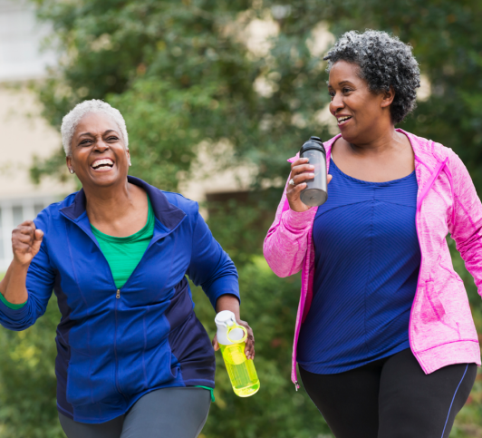
Behavior Change
Cognitive behavioral strategies
Physical activity knowledge and awareness
Goal setting
Self-monitoring
Barrier identification and problem-solving
Social support
Physical activity counseling
Notes:
Behavior change strategies use individual-level approaches to influence knowledge, skills, attitudes, and beliefs related to physical activity.
Behavior change approaches are often components of physical activity programs and interventions and are an effective way to increase physical activity self-efficacy and change physical activity behavior.
Physical activity counseling may be led by physical therapists, occupational therapists, or other exercise and health professionals who work with older adults and can include a variety of cognitive behavioral strategies — such as building physical activity knowledge or awareness, goal setting, self-monitoring, barrier identification and problem solving, and social supports.
For example, through physical activity counseling, an older adult might identify lack of motivation as a barrier to physical activity, and an exercise professional might encourage them to join a walking group or start a “buddy system” to provide friendship, emotional support, and accountability.

Slide 26
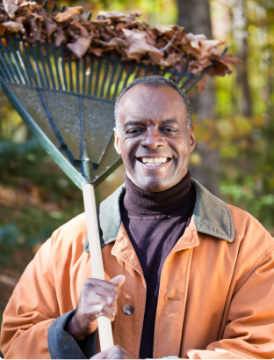
Physical Activity Programs
Exercise programs
Help older adults engage in specific exercises for a set amount of time
Lifestyle-based physical activity programs
Empower older adults to increase their physical activity in ways that fit into their lifestyle
Notes:
Physical activity programs vary widely in the intervention design and strategies used to increase physical activity.
Structured exercise programs guide participants through specific exercises or prescribe a set of exercises for participants to complete.
Lifestyle-based physical activity programs encourage participants to engage in more physical activity throughout the day — typically beyond or in addition to structured exercise.
Both structured exercise and lifestyle-based physical activity programs can help individuals find new ways to be active that fit their everyday lives.

Slide 27
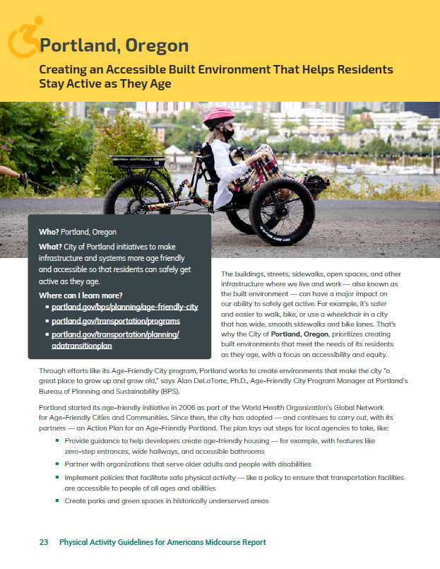
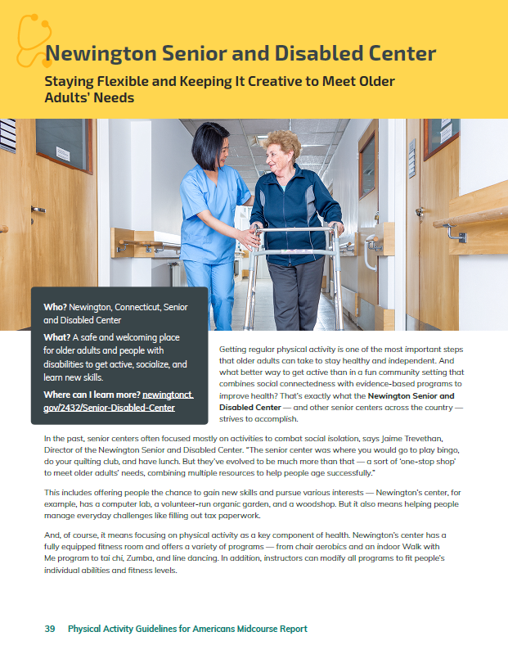
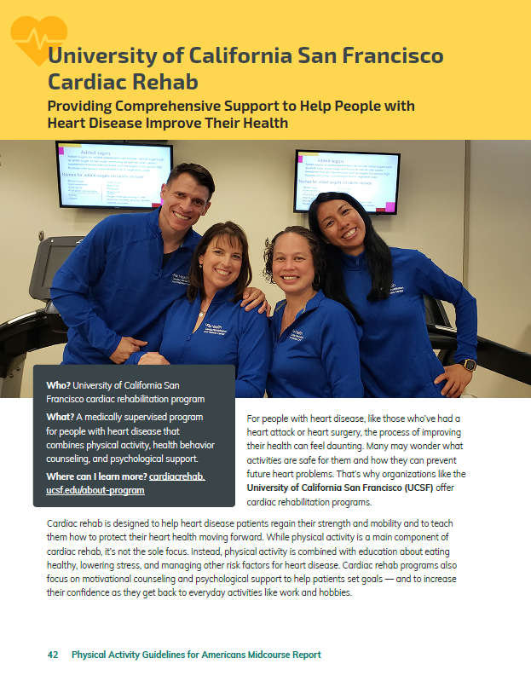
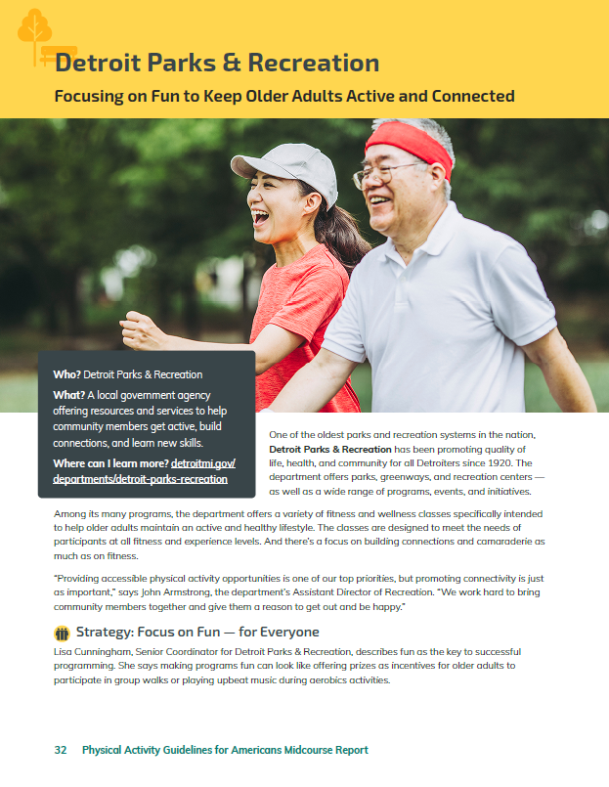
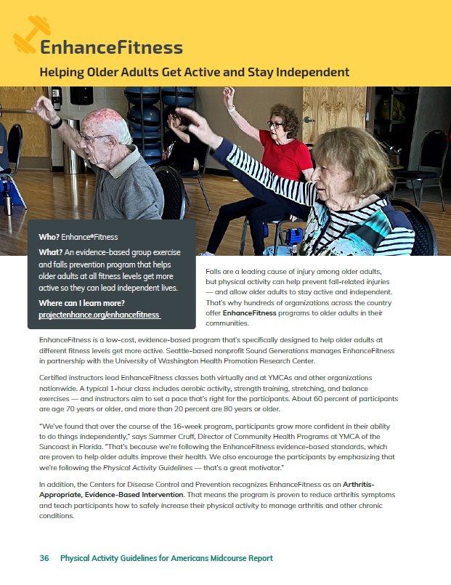
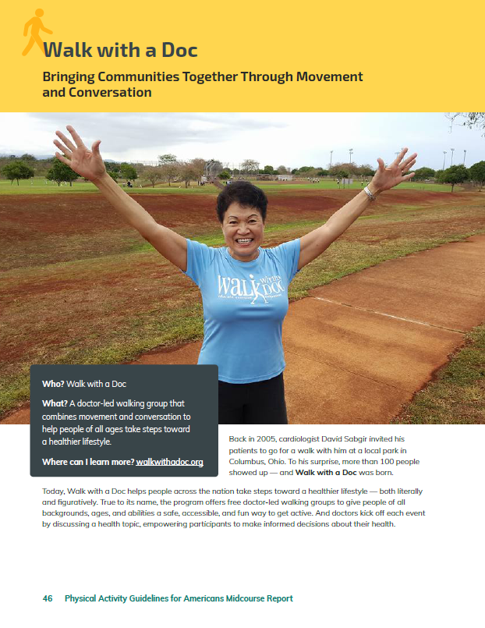
Real World Examples
Notes:
Throughout the midcourse report, you’ll find 6 real world examples to put a spotlight on how different sectors, programs, and communities are implementing the strategies described in the report.
Portland, Oregon the City of Portland prioritizes how to make infrastructure and systems more age friendly and accessible so that residents can safely get active as they age.
Detroit Parks & Recreation is a local government agency offering resources and services to help community members get active, build connections, and learn new skills.
EnhanceFitness is an evidence-based group exercise and falls prevention program that helps older adults at all fitness levels get more active so they can lead independent lives.
Newington Senior and Disabled Center provides a safe and welcoming place for older adults and people with disabilities to get active, socialize, and learn new skills.
University of California San Francisco Cardiac Rehab is a medically supervised program for people with heart disease that combines physical activity, health behavior counseling, and psychological support.
Walk with a Doc is a doctor-led walking group that combines movement and conversation to help people of all ages take steps toward a healthier lifestyle.

Slide 28
Everyone Has a Role to Play
Professionals working with older adults (e.g., exercise and health professionals, clinicians, and gerontologists)
Organizations (e.g., fitness centers, cardiac rehab facilities, parks and recreation departments, and senior living residences)
Community (e.g., civic associations, housing authorities, and those involved in public works, urban planning, and transportation
Policymakers and decision makers (e.g., local and state government officials; Tribal leaders; public facility management, and health insurance companies)
Notes:
And everyone has a role to play in increasing physical activity levels among older adults and encouraging progress toward meeting the Physical Activity Guidelines. The midcourse report includes a list of how professionals working with older adults, organizations, communities, and policymakers and decision-makers can all be involved in this effort.

Slide 29
Professionals Working With Older Adults
Professionals working with older adults one-on-one or in small-group settings are in key positions to support and encourage them to increase their physical activity levels through direct interactions and services
Notes:
Professionals working with older adults in 1:1 or group settings help create trusting relationships, provide direct guidance, and implement those individual-level behavior change strategies or lead physical activity programs.

Slide 30
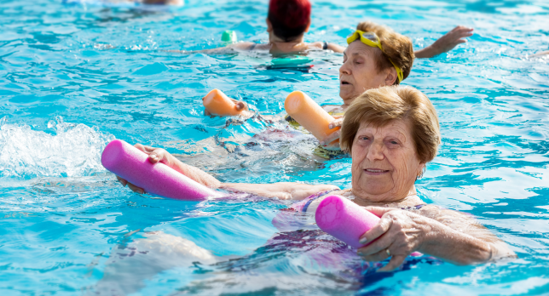
Organizations
Organizations are uniquely positioned to create conditions for older adults to participate in physical activity through programming and interactions at various facilities and locations
Notes:
Organizations have the opportunity to create and manage physical activity programs and provide spaces and facilities for physical activity and social interaction for older adults.

Slide 31
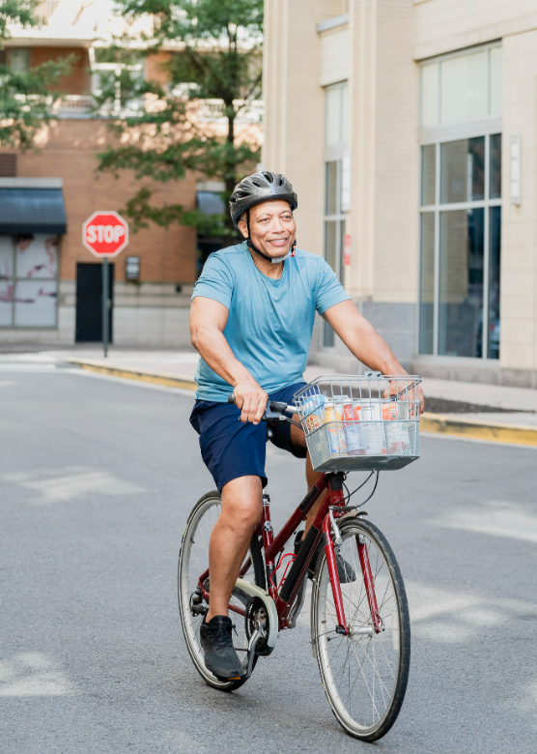
Communities
Community includes the design and atmosphere of public spaces that people can use for physical activity, such as:
Active transportation and public transit infrastructure
Parks, greenways, and trails
Other community design interventions
Notes:
Communities can create activity-friendly and aging-friendly environments through community design that support older adults not only in being able to be active for transportation or leisure but in feeling safe and confident in doing so.

Slide 32
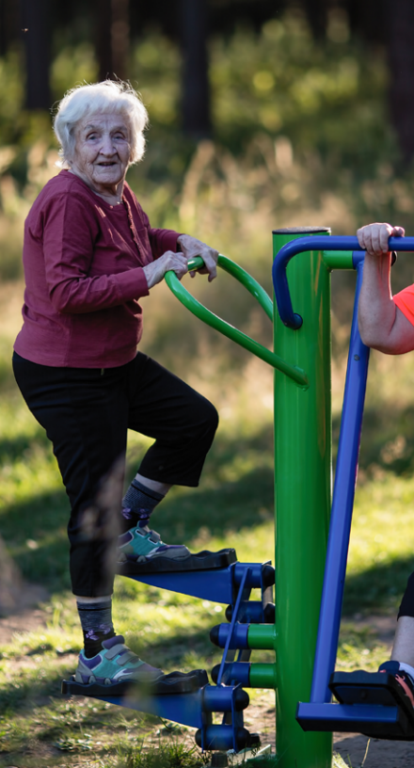
Policy Makers and Decision Makers
Policymakers and decision makers are responsible for creating:
Laws, rules, regulations, codes, and funding at various levels of government
Corporate policies
Institutional rules and policies
Notes:
And finally, policymakers and decision makers are responsible for setting the policies that either facilitate or create barriers to activity.

Slide 33
Tools and Resources
Notes:
In addition to using the midcourse report itself to guide your efforts, we encourage you to use the suite of Move Your Way campaign materials for older adults to help you promote physical activity.

Slide 34
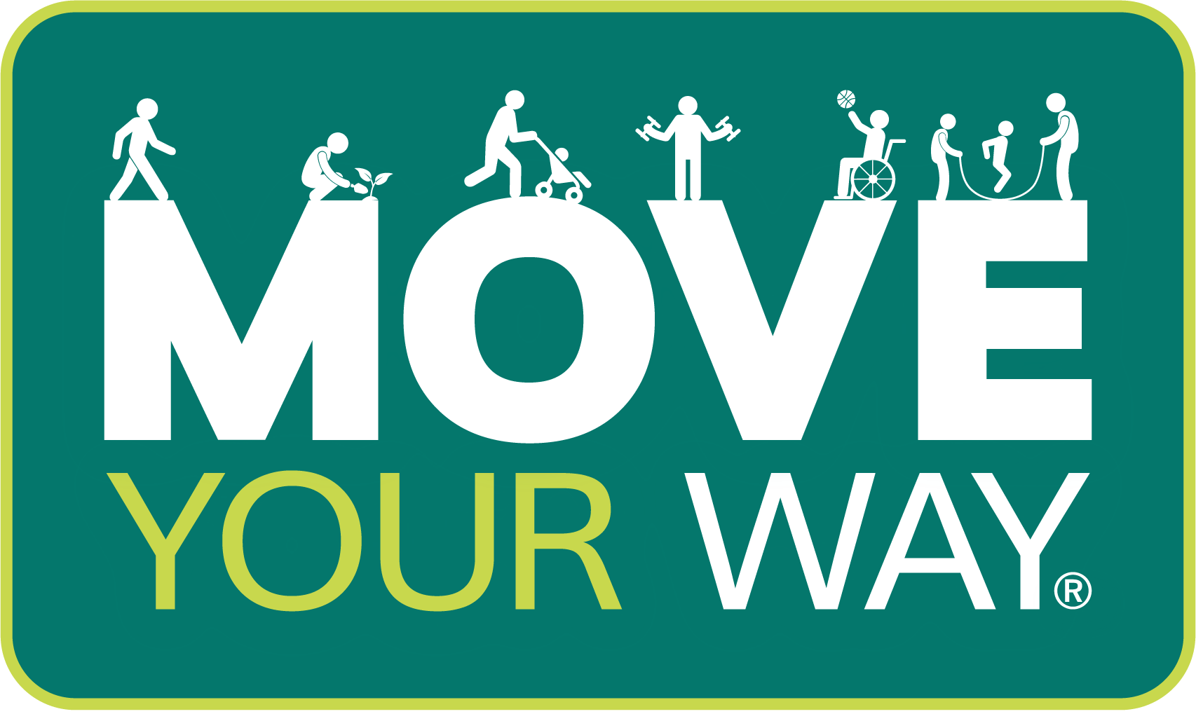
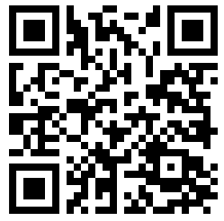
Move Your Way® Campaign
Translates the Physical Activity Guidelines into easy-to-understand information
Materials are:
Ready-to-use
Tailored to different audiences
Based on people’s needs
Scan the QR code to learn more!
Notes:
Move Your Way is the promotional campaign for the physical activity guidelines. All campaign resources are free to download on health.gov, available in English and Spanish, and user tested to ensure the messages are motivating to the audience they’re trying to reach.
The QR code on this slide will take you to an introductory video where you can learn more about the campaign.
[Link: https://www.youtube.com/watch?v=owpwsnBTpP8]

Slide 35
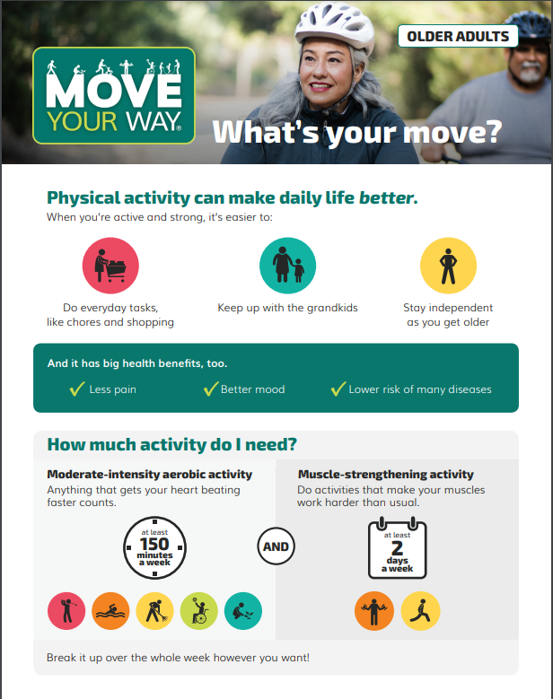
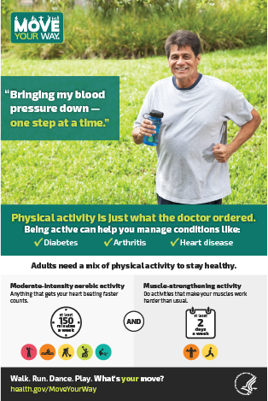
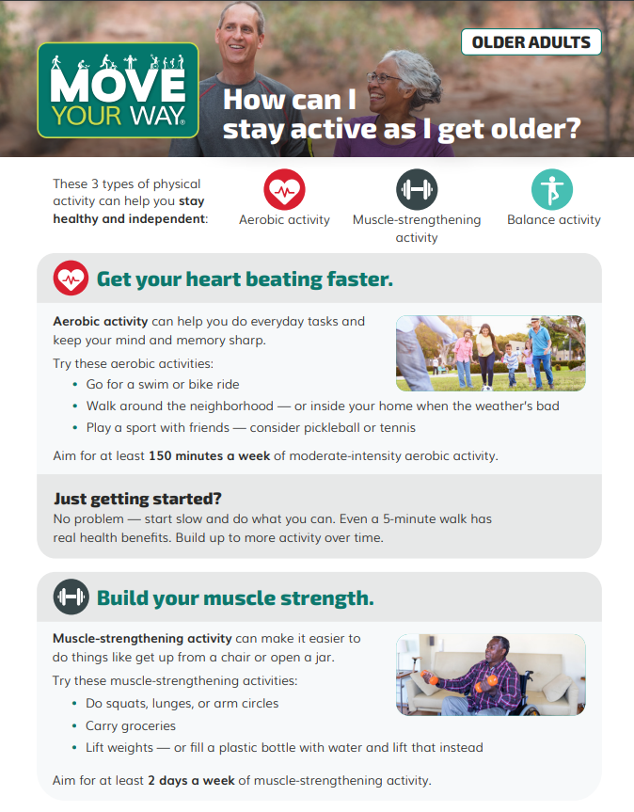
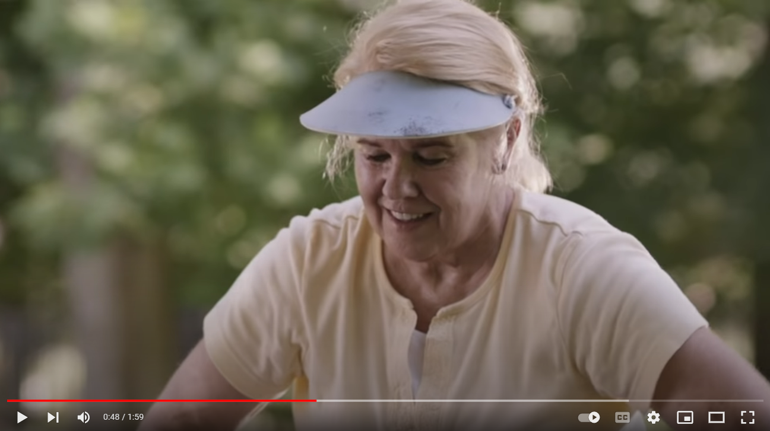
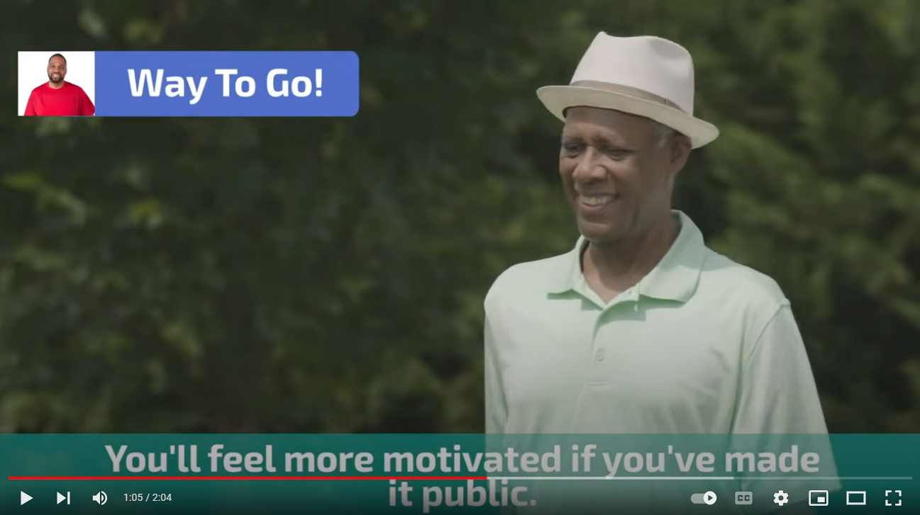
Move Your Way® Campaign Materials for Older Adults
Fact Sheets
Posters
Videos
Notes:
There are several Move Your Way resources specifically designed for older adults.
There are fact sheets, posters, and videos that explain why physical activity is key to healthy aging, what kinds of activity older adults need, and tips to overcome common barriers to physical activity.
There is also a fact sheet for health care providers who work with older adults (like geriatricians and family physicians) on how to talk to their older adult patients about getting active.

Slide 36
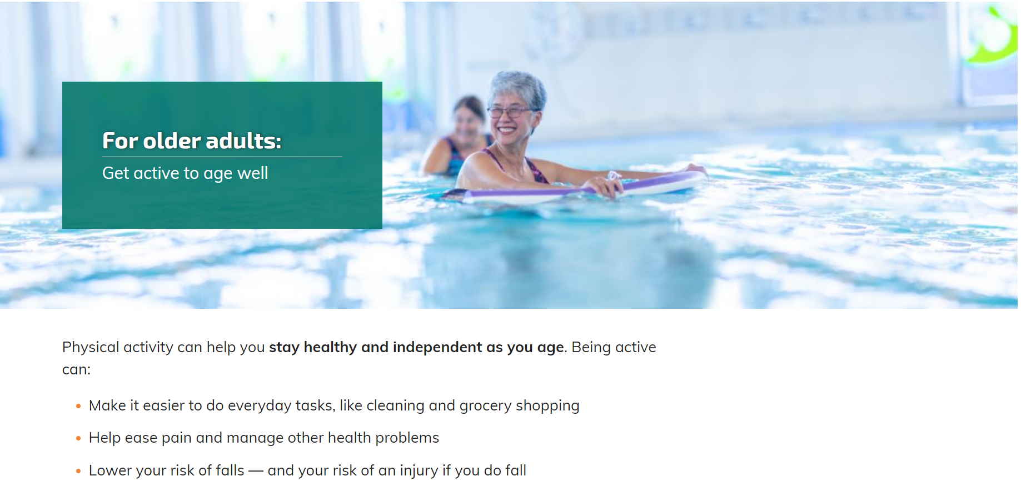
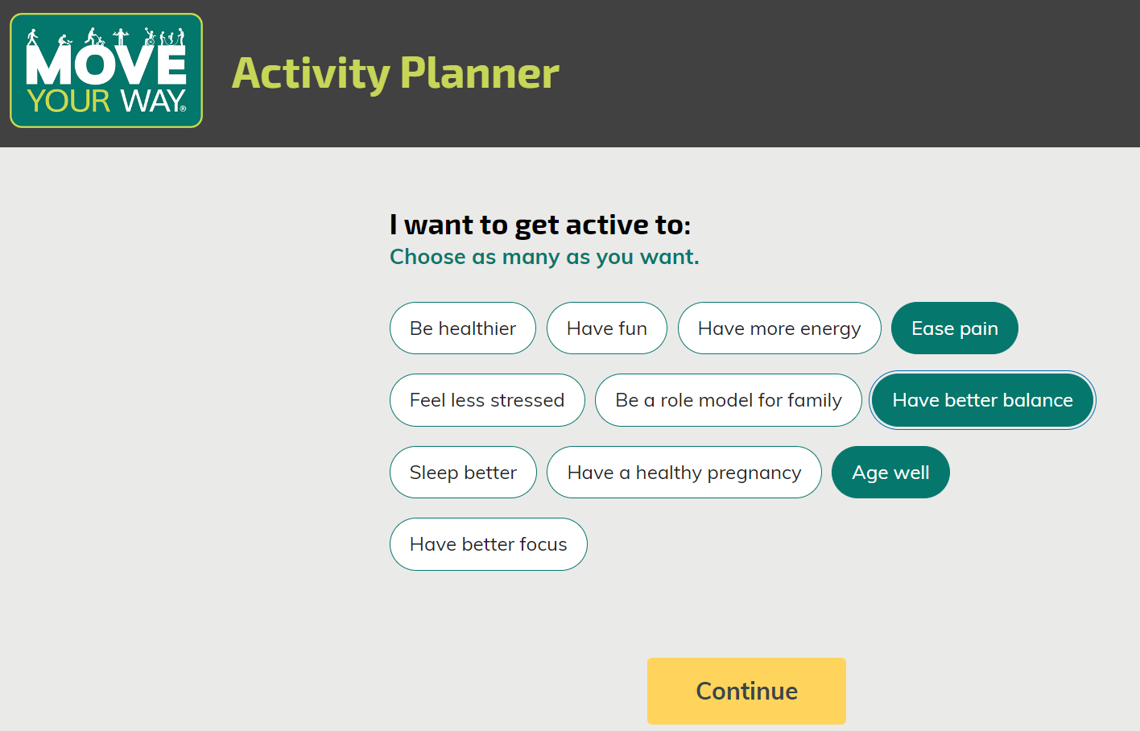
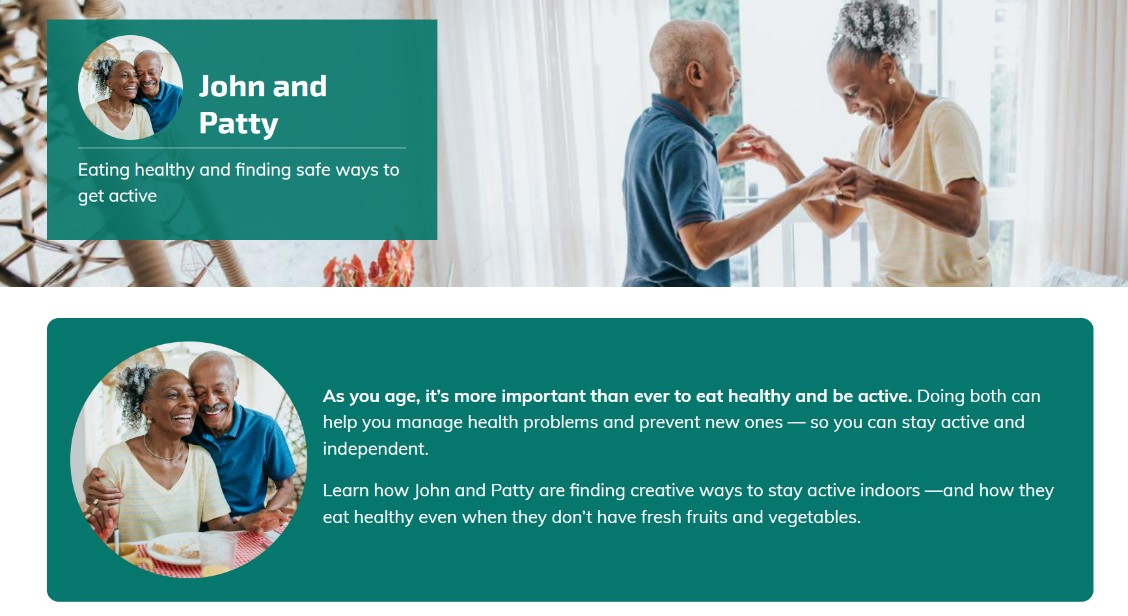
Move Your Way® Microsite (health.gov/MoveYourWay)
Notes:
The Move Your Way materials point people to the Move Your Way microsite, where people can learn more about the benefits of physical activity, find tips to get moving, and create a personalized physical activity plan using an interactive tool.
The Move Your Way website has a specific section for older adults and the activity planner includes different motivations for being active, several of which resonate with older adults, like ease pain, have better balance, and age well.
When users select these motivators and make their activity plan, they get specific tips and resources about healthy aging, like information on how physical activity can help reduce older adults’ risk of falls, or other resources they may be interested in, like this story of how an older couple pictured here, find creative ways to eat healthy and get active indoors.

Slide 37
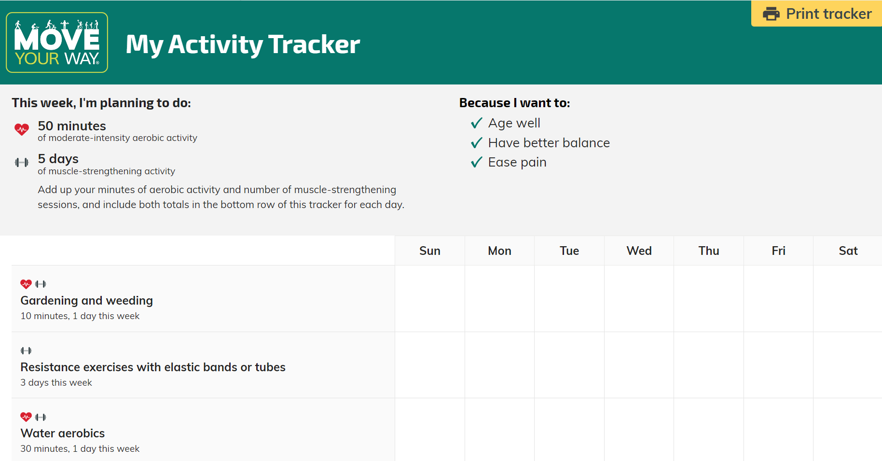
Notes:
And, after making their plan, they can print out a personalized tracker to keep a record of the activities they plan to do that week, which can help older adults set goals and track and monitor their progress.

Slide 38
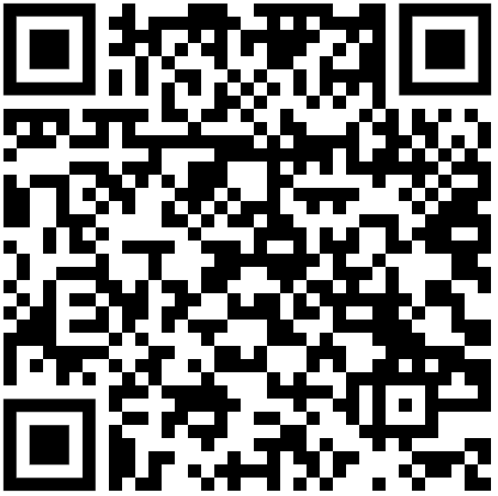
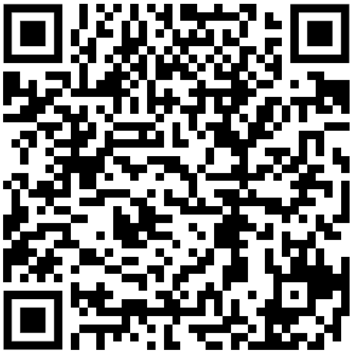
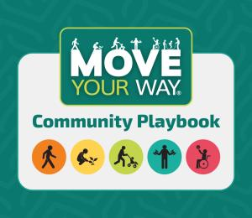
Get Started With Move Your Way!
Explore the Move Your Way Community Resources!
Find all Move Your Way campaign materials!
Notes:
I encourage you to explore and use these free resources.
The QR code on the left side of this screen will take you to the Community Resources page where you can learn more about the campaign, find a partner promotion toolkit, and use the Move Your Way community playbook, an implementation guide with resources to help you promote physical activity in your community.
The QR code on the right will take you to the campaign materials page where you can find the materials for different audiences, like older adults and health care providers. You can also go to health.gov/moveyourway to test out the move your way microsite yourself and make your own physical activity plan!
[Community Resources Link: https://health.gov/our-work/nutrition-physical-activity/move-your-way-community-resources]
[Campaign Materials Link: https://health.gov/our-work/nutrition-physical-activity/move-your-way-community-resources/campaign-materials]

Slide 39
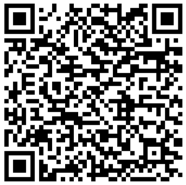
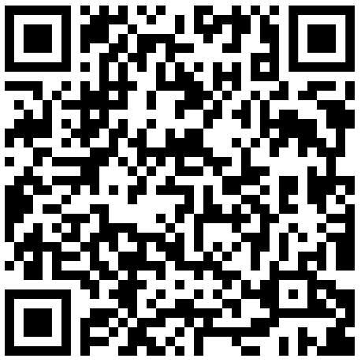
Learn More About the Physical Activity Guidelines!
Explore the Midcourse Report and related resources!
Sign up for physical activity email updates!
Notes:
In addition to using the Move Your Way materials, we encourage you to download and read the midcourse report and sign up for email updates to stay up-to-date on the Physical Activity Guidelines, Move Your Way campaign, and other physical activity content!
[Midcourse Report Link: https://health.gov/our-work/nutrition-physical-activity/physical-activity-guidelines/current-guidelines/midcourse-report]
[ODPHP Physical Activity Listserv Link: https://public.govdelivery.com/accounts/USOPHSODPHPHF/subscriber/new?topic_id=USOPHSODPHPHF_92]

Slide 40
Active People, Healthy NationSM

Slide 41
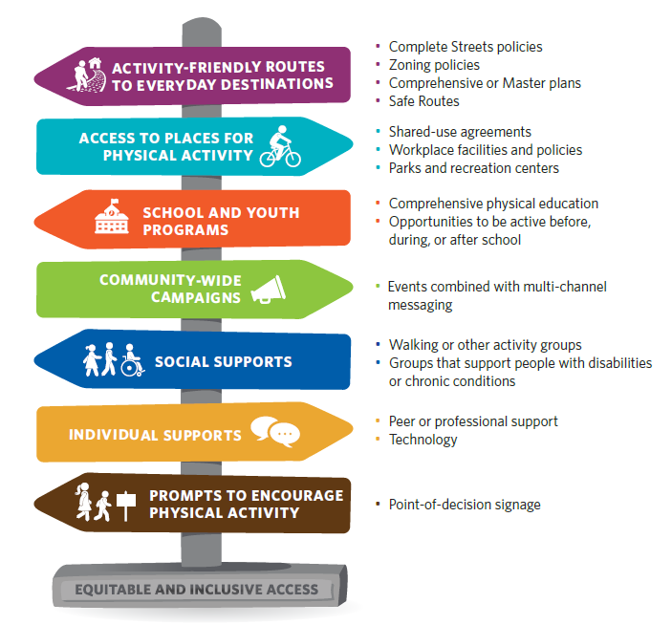
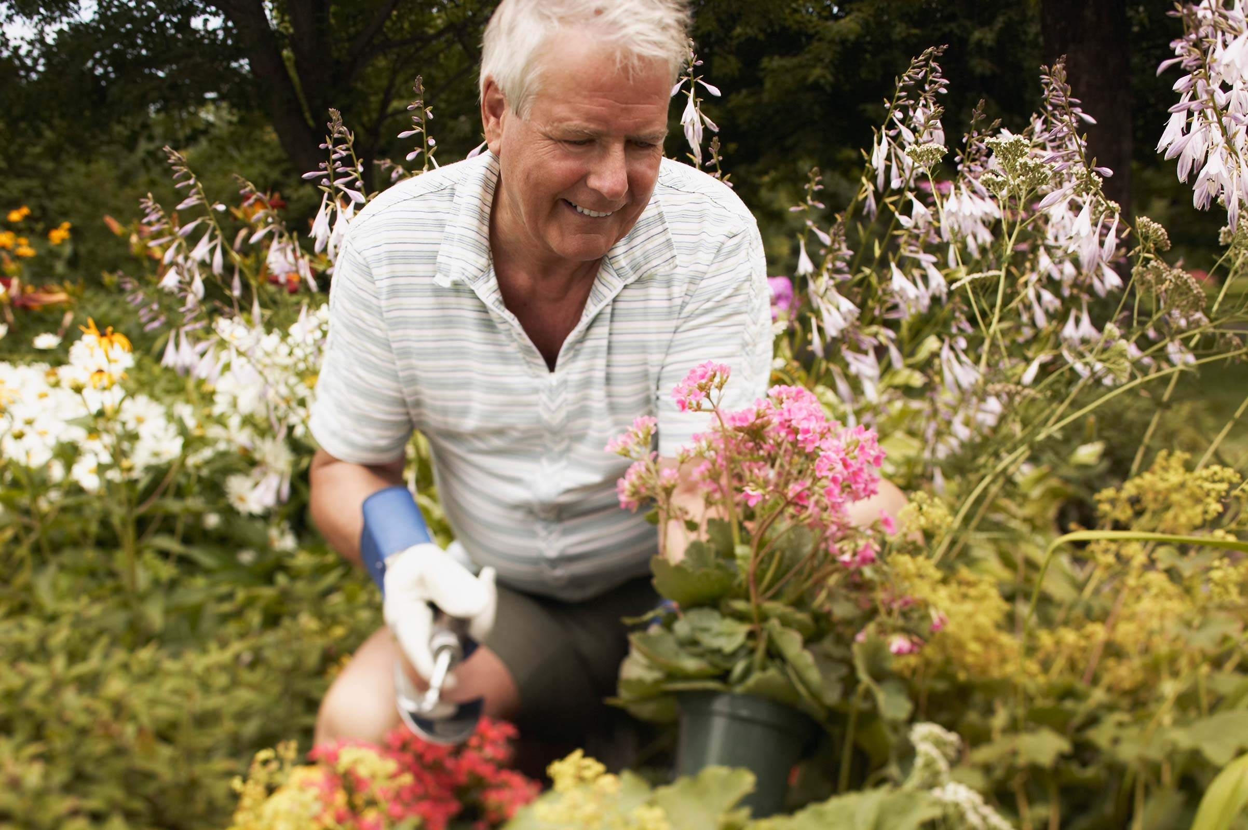
Strategies That Work
Notes:
These are evidenced based physical activity strategies that have been recommended by the Community Preventive Services Task Force and are Community Guide recommendations. Activity-friendly pedestrian, bicycle and public transportation routes to everyday destinations where older adults go (for example, parks and greenspaces, workplaces, healthcare settings, grocery shopping) are important to provide opportunities for active commuting among older adults.
Social support interventions are also important for older adults. Interviews with Mall Walkers who tend to frequently be in the older adult demographic indicate that the social connectedness and camaraderie associated with mall walking programs may be as important as the opportunity to be physically active.
[Learn more: https://www.cdc.gov/physicalactivity/activepeoplehealthynation/strategies-to-increase-physical-activity/index.html]

Slide 42
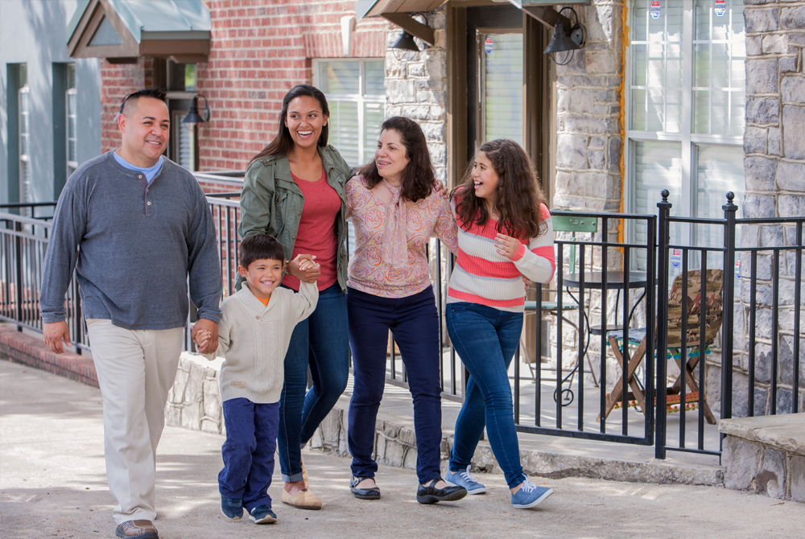
Designing Communities for Physical Activity
Combine interventions from two major categories
Pedestrian or Bicycle Transportation Systems
Land Use and Environmental Design
Photo available from the State and Community Health Media Center: https://nccd.cdc.gov/schmc/apps/overview.aspx
Notes:
The Community Preventive Services Task Force recommends community design such as pedestrian, bicycle and public transportation systems be combined with land use and built environment destinations such as parks, schools, and other destinations. If these interventions take into account ways to be inclusive of older adults, children, and adolescents, all community members will benefit.
Safe routes to destinations may need to consider the American with Disabilities Act, Architectural Barriers Act and Principles of Universal Design to make community designs inclusive and accessible for people with disabilities and older adults with mobility limitations.
[Link: https://www.thecommunityguide.org/findings/physical-activity-built-environment-approaches.html]

Slide 43
Parks, Trails, and Greenway Interventions to Increase Physical Activity
Park, Trail, and Greenway Infrastructure Improvements
Developing new parks, trails, or greenways
Improving existing parks, trails or greenways with additions or upgrades
Additional Activities
Community engagement
Programming
Public awareness
Access enhancements
Notes:
Parks can play a central role in improving the physical, emotional, mental, and social health of older adults. Park infrastructure improvements can not only help to increase physical activity and park use among community members, but may also be a good community investment. A systematic review of economic evidence from seven studies found a median benefit to cost ratio of 3.1, meaning every dollar spent led to $3.10 worth of benefits. Economic benefits included improved health due to physical activity or the value of the infrastructure to users for recreation or relaxation.
[Learn more: Economic Review Highlights Costs and Benefits of Park, Trail, and Greenway Infrastructure Interventions | The Community Guide]
The National Recreation and Park Association, supported by CDC, translated the Community Prevention Services Task Force recommendation into the Active Parks! Implementation Guide: Active Parks! Implementation Guide | Best Practice Resources | Publications and Research | NRPA
[Link: https://www.nrpa.org/publications-research/best-practice-resources/active-parks-implementation-guide-increasing-physical-activity-through-parks-trails-and-greenways/]
[Link: https://www.thecommunityguide.org/findings/physical-activity-park-trail-greenway-infrastructure-interventions-combined-additional-interventions.html]

Slide 44
Tools for Action
Notes:
Learn what you can do to increase physical activity by sector.
Older adults can be physically active in a variety of settings. Community or master planning among multiple community sectors and personnel can best ensure that communities are age- and physical activity-friendly. Healthy and independent aging in place requires that communities be livable and this includes safe walkable and bikeable opportunities.
[Link: https://www.cdc.gov/physicalactivity/activepeoplehealthynation/everyone-can-be-involved/index.html]

Slide 45
Thank You

